Slide 1
Tidal Hunters
Individual Game assignment
Presented by
Jojo Noyes

Slide 2
Overview
Tidal Hunters
Tidal Hunters is a cooperative, online, networked sci-fi FPS with a strong focus on boss-rush combat. The game blends mechanical inspirations from Helldivers 2, Elden Ring, and other co-op action titles to create challenging, team-based encounters.
The game’s theme centers around hyper-urbanization, corporate domination, and religious horror, expressed through world-building and lore.
Its visual style aims for gritty, stylized realism, taking influence from Helldivers 2 and other futuristic military aesthetics. Weapons and technology draw inspiration from various sci-fi media.
Overall, Tidal Hunters is designed as a cooperative FPS experience built around intense boss fights, lore-driven worldbuilding, and a grounded but stylized sci-fi tone.

Slide 3

Demo

Slide 4
Production Cycle
Let take a look at how I attack issues.
Get an idea (multiplayer game, invite menu, boss fight)
Figure out how it works (Chat GPT, Youtube, Professionals, ect.)
Make a prototype on paper or mentally
Try to make it
For example on my JS server and DB stuff, I spent a long time trying to map it out. I talked to Jack, Chat GPT, Boon, and other places to just understand the flow. I then drew it on paper figuring out how the code will be mapped, then I produced the back end over the span of a couple of months with all my information.
Overview for whole project went
Idea and iteration
Prototype
Redo everything
Restart Idea and iteration
Begin to build the whole thing
Realize I need a game
Build said Game
Rebuild from scratch even better
Here we are now

Slide 5
GIMM 290
In this class I prototyped a multiplayer alien fishing game, and started developing using the current networking framework of fishnet. I had a simple fishing game with a shop and could play with 2 players on a listen server.

Slide 6
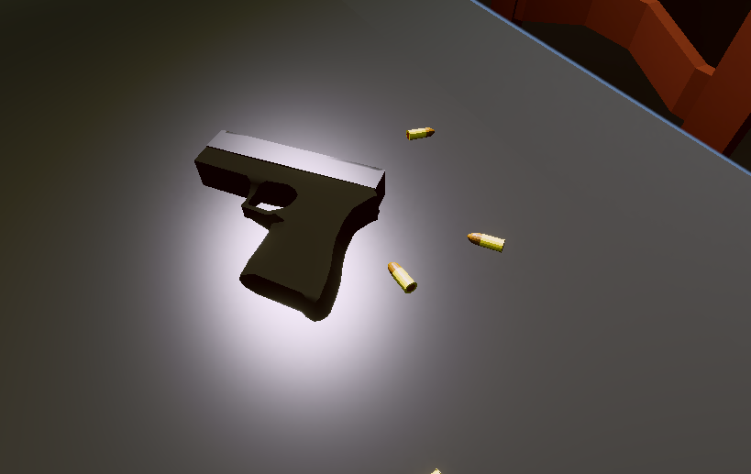
GIMM 330
In Amods 3D modeling I learned how use Maya efficiently. I had dabbled in it before, but as of right now for this game, I have only created one model. It is a 2 piece handgun model which will be animated and fit into my project once I get to the asset stage.

Slide 7
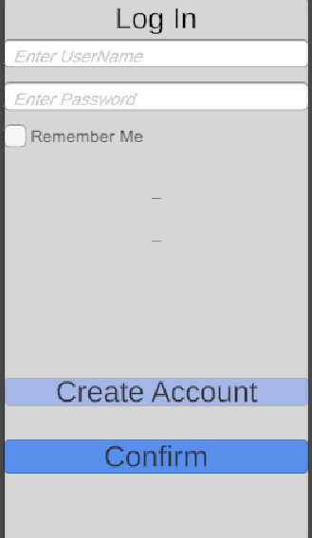
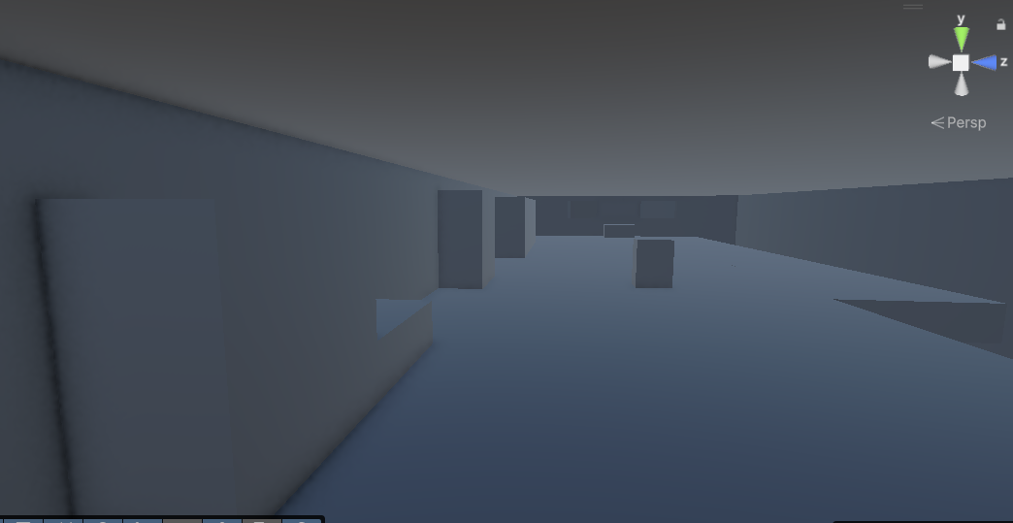
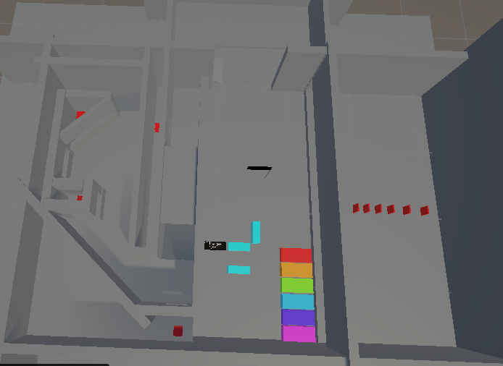
GIMM 350
In GIMM 350 I completely flipped my design for my game. I decided to create a coop 1st person shooter in a space I hadn't seen filled. My original level design and work in this class was on the backend and unity integration. I had a Login and servers on the cloud, and player management through my own backend called Foxtooth. By the end of the semester I realized I needed actually some gameplay. So I created a simple shooting range.
The next 3 slides will be quickly over code I developed in this class

Slide 8
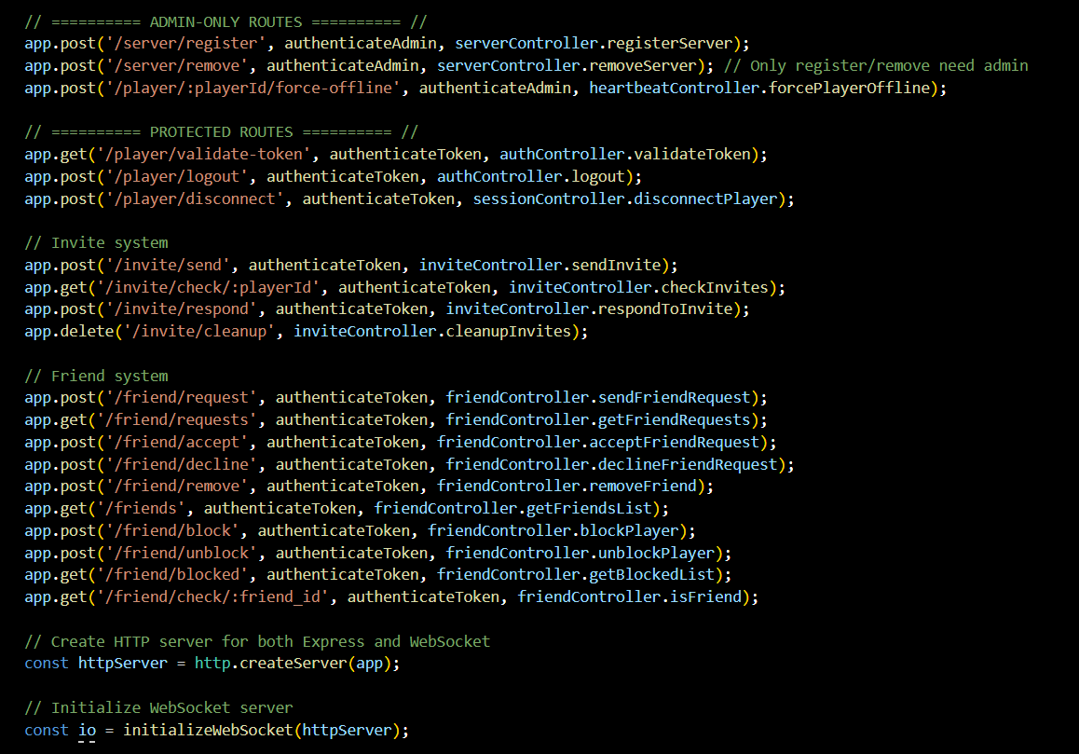
JS Backend
How this backend works, is we use node JS to expose our server to http. So as long as you have a secure IP address you can access the backend online, and send commands to it and such. So all versions of the game connect to it via HTTP and then send commands to the server to register it to the database.
My node JS backend is made up of 20 scripts, all working together to interact with a SQL database made up of 8 tables which manages all Player accounts, friendships, invites, server, and security.
I have also hooked unity into unity into the JS backend which allows
Players to create accounts, login, and play the game
My JS server, Database, and game servers are all currently online
and active on AWS.

Slide 9
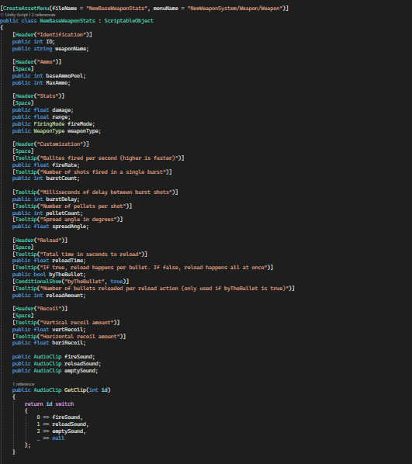
Weapon Scriptable Obj
What allows me to create and manage weapons so quickly

Slide 10
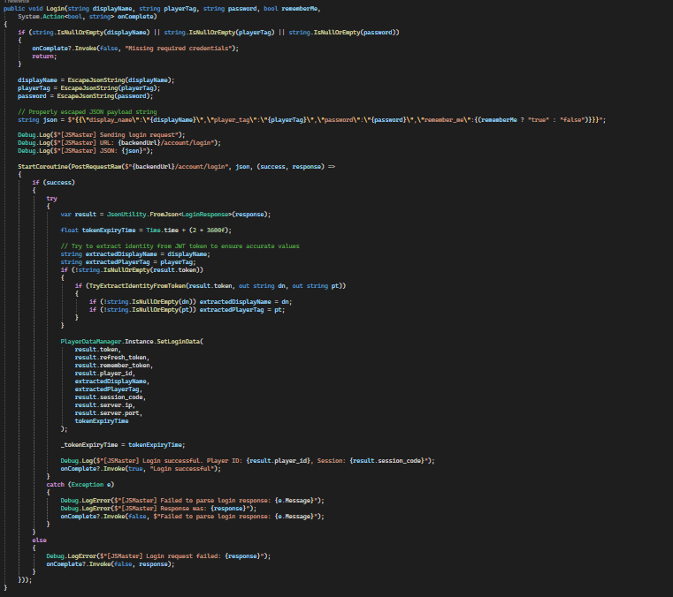
Unity & Game side
Much of my current game code in unity is all just built around communicating with the JS server. We do this by using Unity Web Requests, which allow you to access http and https from inside unity
This is my Login Function for my game.
The client Inputs their login information and sends it to the JS Server
The server checks it against the database
If its validated, it finds a game server and connects them to a open port.

Slide 11
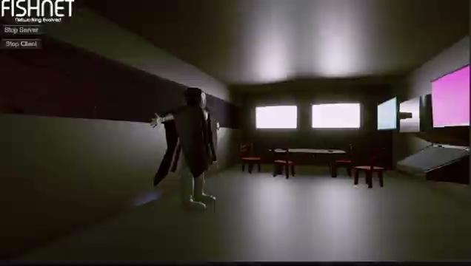
GIMM 360
In GIMM 360 I mostly worked in VCV rack for some audio in my game. Honestly most the audio developed in vcv did not find a place in my game. But many of the sound effect I created in this class did. It helps immerse into the game and the sounds of all of it.

Slide 12
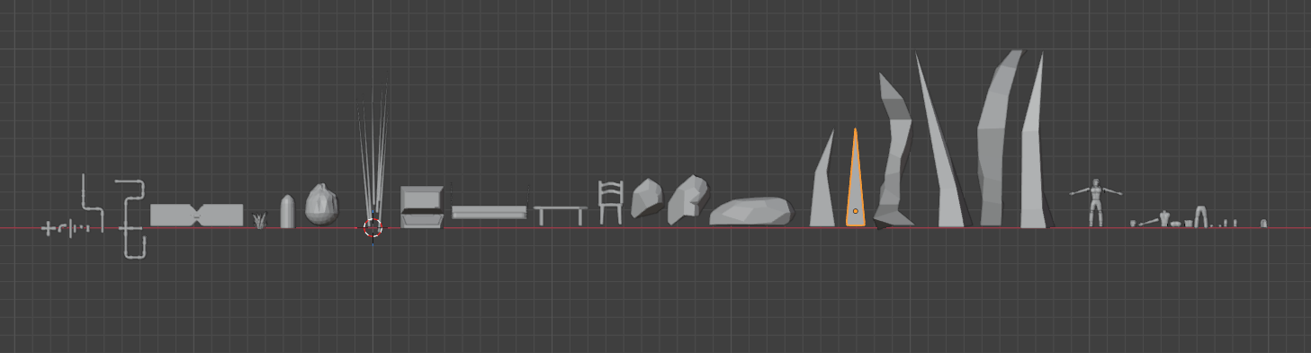
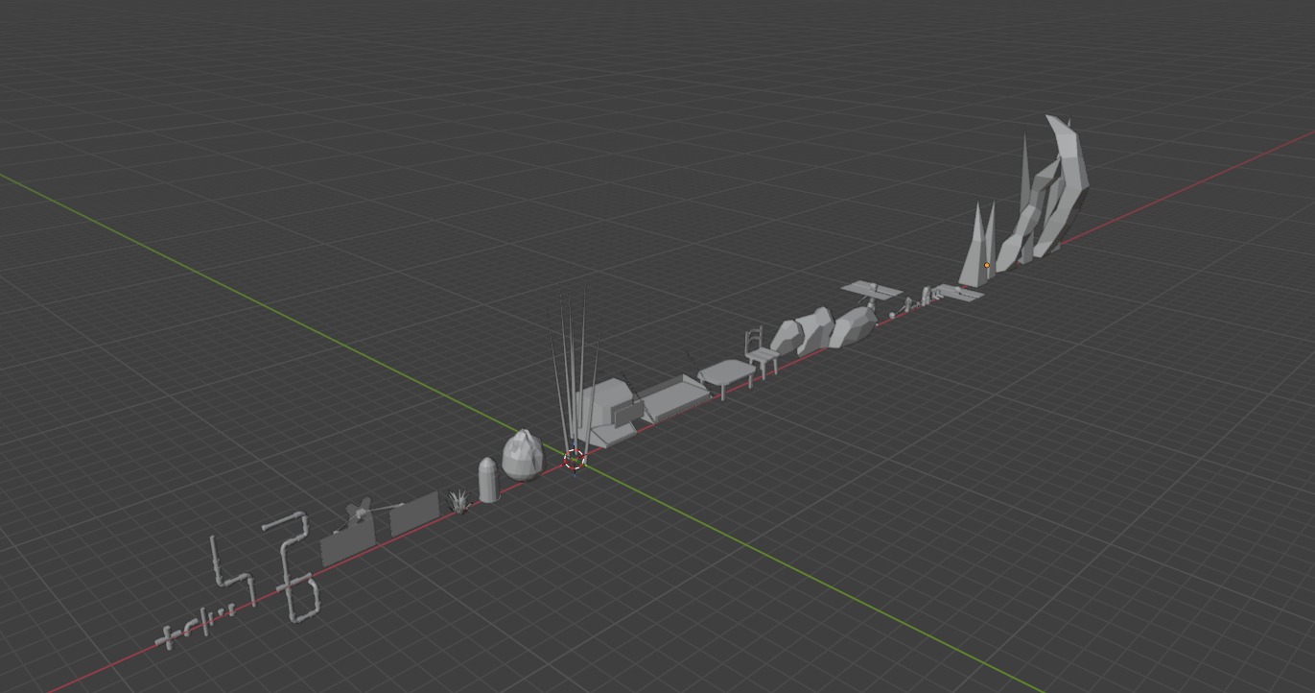
GIMM 370
In GIMM 370, I worked on a lot of modeling. I created a hero player asset, with many many decorations for that arena and lobby areas.

Slide 13
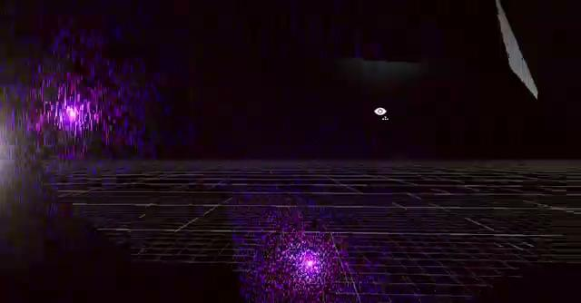
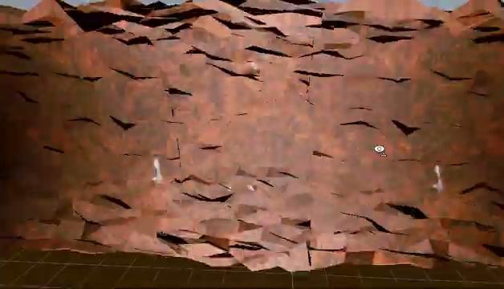
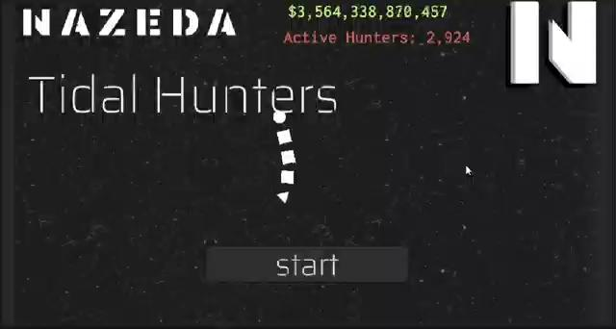

GIMM 375
For this class I created lots of cool shaders and I also decided to delve into HLSL as well.
My tunnel, void pond, and crystals are all shaders in game. I also have a boss which is procedurally animated.
My main menu has a procedurally animated with the snake guy, and always ticking numbers
TESTING

Slide 14
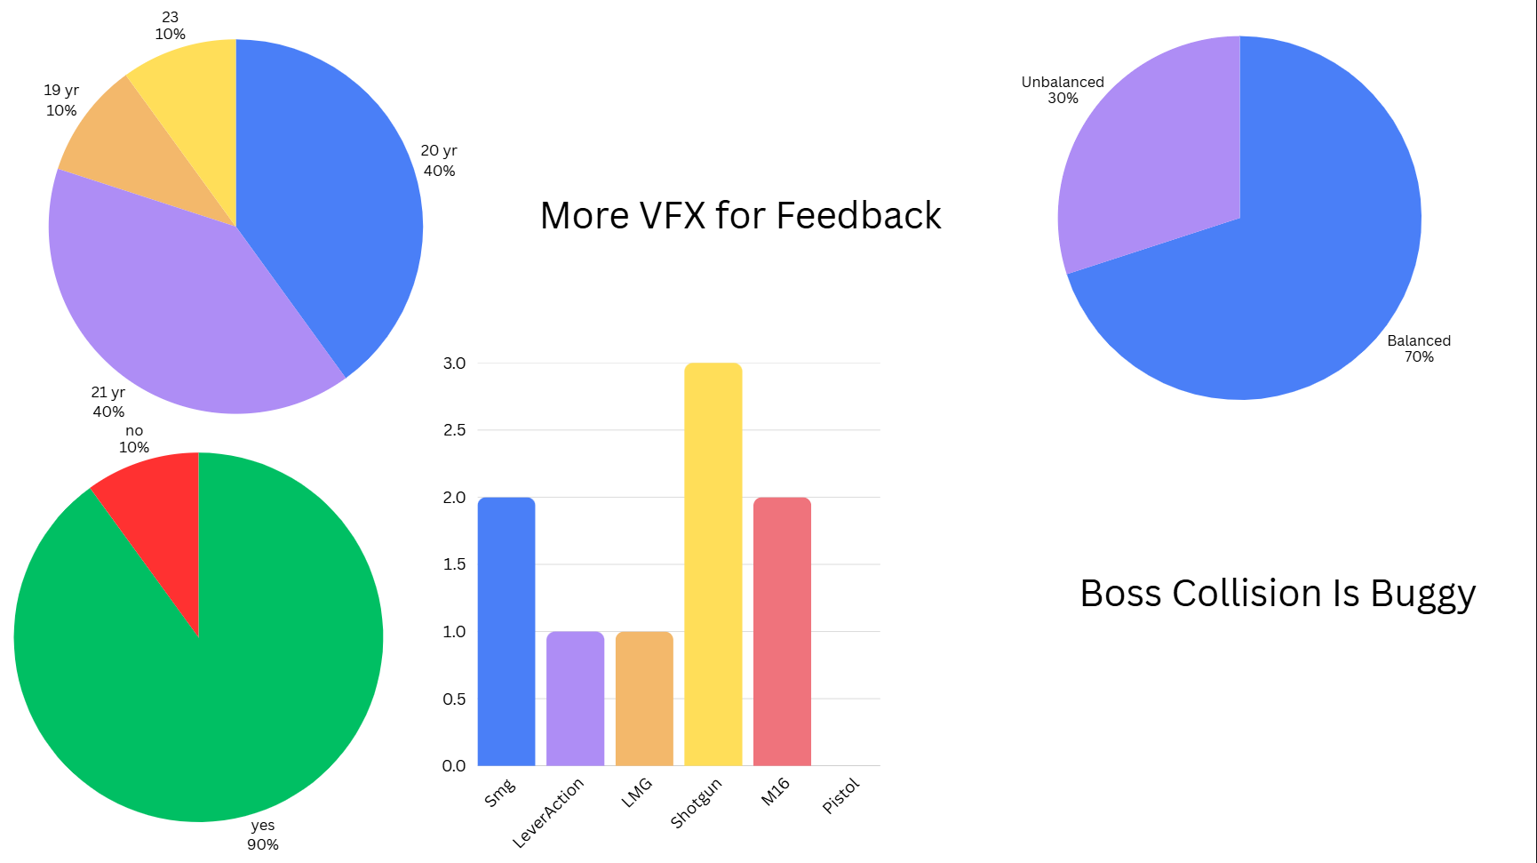
UX Testing
I currently don't have a whole lot of testing actively available for my game, but I was able to grab some statistics which helped me understand some areas I could improve on.
My demographic was 60% 20 year old players, who frequently play Online multiplayer games often daily
The average time to create an account was 48 Seconds, and 4/5 Testers entered login details thinking that would create an account. So here I will clarify and emphasize the create account button. But on the other hand we had a account creation Ease score of 5/5. It was very easy for testers to create accounts.
The average missed shots count was 40, and average miss percentage was 80%. My aiming was not consistent, and I have since changed the system, as this was not a issue of the players
My weapon system had a average score of 2.33 out of 5 which was mostly credited to the high recoil and poor accuracy. With this insight I can easily clean up the system.
Despite the issues my players expressed interested in playing a fleshed out version of the test they played. Despite the rough gun system, people seem to like the multiplayer side of things and concept of the game.

Slide 15
Future Development
The Future development of Tidal Hunters would be very interesting I have been planning a lot and if I wanted to go over all the ideas I have we would be here too long. So let's look to a possible release
Polish current gameplay and get servers back online for multiplayer testing.
Create multiple bosses which can be fished up
Finish and polish the attachments and weapons
Balance
Test
Integrate lots of lore and “betting drones”
Create a community to build the lore
I have so many ideas to build into this game but I don't know if I will be able to handle the development alone. We may be looking to adopt this project with my team I work with but for now I will be polishing the current boss and network gameplay

Slide 16
Conclusion
There’s still a lot I want to build for this game. This has been one of my favorite projects and there are actually tons of systems in the background working that you guys cannot see. For example I have the attachment system in and working but I didn't have time to model for all of them and stat adjustments.
But for now this is Tidal hunters

